Slide 1
Advances in Reading Assessment and Interventions for Pre-School and School-Aged Children
Philip Levin, PhD
Program Director, The Help Group-
UCLA Neuropsychology Program

Slide 2
Advances in Three Domains
Causation Research
Diagnosis
Assessment

Slide 3
Topic # 1
Advances in Causation Research

Slide 4
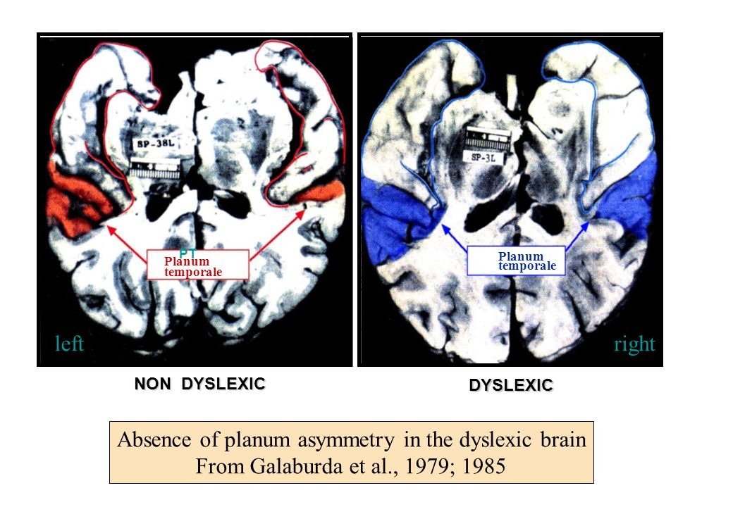
Galaburta, 1994
Notes:
symmetry in the temporal plane, where there should be asymmetry, and cellular lesions
in the brain of a 20 years-old dyslexic who died accidentally

Slide 5

3 neural pathways for reading
Parieto-Temporal
Word Analysis
Mental Images of Letters
Recognition of words
Broca’s Area
analysis of speech sounds
& phonotactic frequency
Occipital Temporal
Instant Word
Recognition

Slide 6
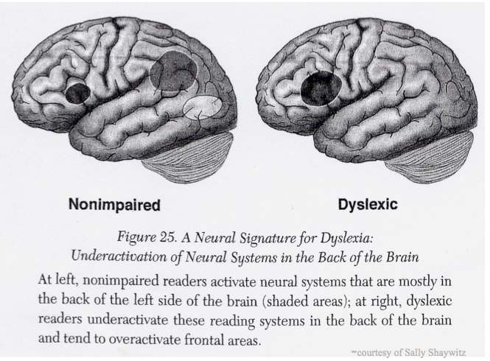

Slide 7
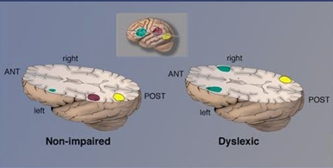
Reliance on ancillary
systems
Word Form Area
Fails to form
Remediation compensates for
accuracy not automaticity

Slide 8
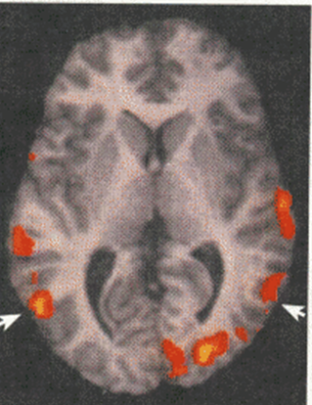
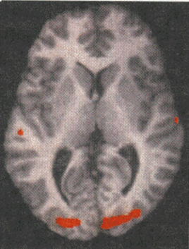
An overreliances on certain areas
of the brain leads to
inaccurate and/or
slow, effortful reading that
typically originates with
weaknesses in the
phonological processing
system of language – Shaywitz, 1992
Non -impaired brain while
reading
Child with reading disability
While reading

Slide 9
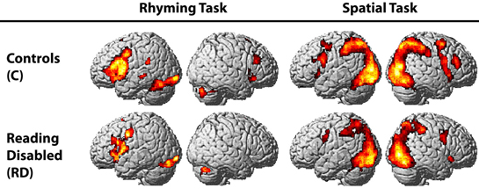
Geshwind, 2003

Slide 10
Galaburta, 2012
We know that most people with Reading Disorders
have structural differences in the brain that differs from those who do not have difficulties with the acquisition of reading
BUT
We don’t know what causes the structural differences
We don’t know if the structural differences are the cause or the effect of poor decoding abilities
We don’t know why all people with structural differences do not develop reading disorders

Slide 11
Causes of Structural Differences
Genetic
Environmental
Anecdotal Data
Genetic Data
  FOXP2 gene that, when disrupted, causes a complex speech and language disorder and structural brain differences (Lai, Fisher, Hurst,, 2001)
  GNPTAB gene that is causal in expressive delays including stuttering (Kang et al., 2010)
Literacy Rich Environment
Quality of Instruction

Slide 12
Language Rich Environments
Exposure to varied vocabulary.
  Knowing the “right word” is vital if one is to communicate information clearly. Large vocabularies have long been known to be linked to reading success (e.g., Anderson & Freebody 1981
Opportunities to be part of conversations that use extended discourse.
  Extended discourse is talk that requires participants to develop understandings beyond the here and now and that requires the use of several sentences to build a linguistic structure, such as in explanations, narratives, or pretend talk.
Home and classroom environments that are cognitively and linguistically stimulating.
  Children are most likely to experience conversations that include comprehensible and interesting extended discourse and are rich with vocabulary when their parents are able to obtain and read good books and when their teachers provide classrooms with a curriculum that is varied and stimulating.

Slide 13
Literacy Rich Environments
Most children enter K with knowledge of typical 8,500 most common words in the English language
Exposure to less common, more sophisticated vocabulary at home relates directly to children’s vocabulary acquisition.
Good readers combine a variety of strategies to read words.
Children who acquire strong vocabularies increase their ability to make sense of what a word might be while using what they know about phonics.
Language- poor families are likely to use fewer different words in their everyday conversations
  The language environment is more likely to be controlling and punitive.

Slide 14
Literacy Rich Environments
Relationship Between Home Literacy Environment and Reading Achievement in Children with Reading Disabilities - Fontina L. Rashid (2005)
  Parents' home literacy activities were significantly related to children's passage comprehension and spelling scores
Home Literacy Environment and Its Role in the Achievement of Preschoolers With Disabilities - Elaine Carlson (2010)
  Home literacy environment of 3- to 5-year-olds was a significant predictor of scores on a test of receptive vocabulary and reading comprehension in later years.
Maternal literacy practices and toddlers’ emergent literacy skills - Claire Maples Edwards (2014)
  Mothers engaged in several emergent literacy behaviors with their toddlers during shared-reading interactions. Some of these behaviors were also exhibited by their children. The behaviors observed in mothers and toddlers were related to the written language awareness domain

Slide 15
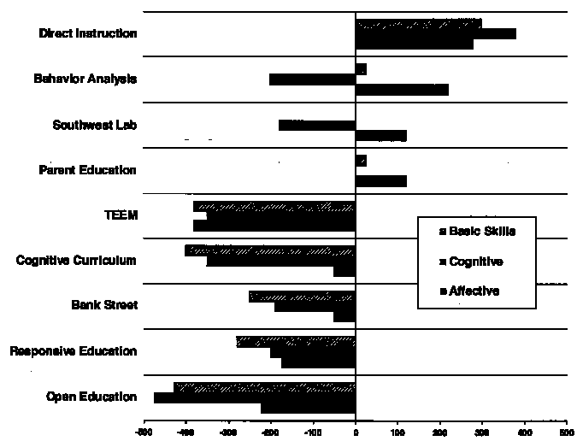
Quality of Instruction
A 2011 federal study analyzing the effectiveness of four widely used direct instruction reading programs
  Spell Read P.A.T.
  Corrective Reading
  Wilson Reading
  Failure Free Reading
After one year of instruction, there were significant impacts on phonemic decoding, word reading accuracy and fluency, and comprehension
Reading skills can only be significantly improved through direct instruction in word-level skills

Slide 16
The Five Pillars of Direct Reading Instruction
Phonemic Awareness Training
Noticing the sounds of spoken language
Phonemic Instruction
Teaching letter-sound relationships (grapheme/phoneme)
Fluency Instruction
Reading text accurately and quickly
Vocabulary Instruction
Instruction in the words necessary for effective communication
Comprehension Instruction
The ability to understand meaning from what is read.

Slide 17
Quality of 1:1 reading instruction
Students taught in small groups of 2-6 students were able
to make the same gains in reading performance as students
taught in one-on-one sessions.
Certified teachers and reliably trained adult volunteers
were equally able to help struggling readers
in both one-on-one and small group settings.

Slide 18
Conclusions
Dyslexia is a specific learning disability that is neurological in origin
  It is characterized by difficulties with accurate and / or fluent word recognition and by poor spelling and decoding abilities.
  These difficulties typically result from a deficit in the phonological component of language
  It is unexpected in relation to other cognitive abilities and the provision of effective classroom instruction
A significant proportion of reading disordered students suffer from additional auditory, visual or motor disorders.
There is a genetic underpinning to Dyslexia
However, genetics alone cannot explain reading differences

Slide 19
Diagnostic Advances

Slide 20
Changes in Diagnosis
DSM-IV
DSM-5
Reading Disorder, Math Disorder , Disorder of Written Expression, and LD-NOS
Specific Learning Disorder
Neurodevelopmental Section
impedes the ability to learn or use specific academic skills (e.g., reading, writing, or arithmetic), which are the foundation for other academic learning
Learning difficulties are ‘unexpected’ in that other aspects of development seem to be fine

Slide 21
Changes in Diagnosis
DSM-IV
DSM-5
Criteria A - one of six symptoms of learning difficulties that have persisted for at least 6 months despite the provision of extra help or targeted instruction
Criteria B - (the affected academic skills are substantially and quantifiably below those expected for age and cause impairment in academic, occupational, or everyday activities, as confirmed by individually administered standardized achievement measures and comprehensive clinical assessment
Criteria C - during the school-­age years, although may not fully manifest until young adulthood in some individuals
Criteria D - Intellectual Disabilities, uncorrected auditory or visual acuity problems, other mental or neurological disorders) or adverse conditions (psychosocial adversity, lack of proficiency in the language of instruction, inadequate instruction) must be ruled out before a diagnosis of SLD can be confirmed.

Slide 22
Summary Changes
Go from 3 diagnoses to 1 overarching diagnosis
Abandonment of the IQ-Achievement Discrepancy
Psychometric data alone are insufficient for a DSM-­5 diagnosis of SLD
  Requires evidence of symptom persistence
  Quantify low academic achievement from multiple sources
    formal and informal school records
    academic portfolios
    instructional history

Slide 23
Diagnostic Concerns
ASHA expressed concern about the omission of oral language as a diagnostic criterion for specific learning disorder DSM-5
ASHA preferred the term specific learning disability, well-established clinical and research term, rather than specific learning disorder.
  Disability addresses the impact of a disorder and represents a lifelong problem.

Slide 24
Diagnostic Concerns
Shaywitz (2013) supports
  (1) Dyslexia, where much is known scientifically and clinically, and the criteria are based on science;
  (2) the less well-defined Other Learning Disorders where the pathophysiology, neurobiology and mechanisms, which are less well understood, find a home.
Harming and discriminating against patients by denying a diagnosis to individuals with dyslexia and related learning disorders who are bright, demonstrate an unexpected difficulty in reading and read slowly with great effort
  While dyslexia may significantly and negatively impact the affected individual, at the same time, there may be no or little noticeable negative impact on academics or occupational performance
Overlooking the needs of older children and adults by limiting the criteria to school age children, and, thus, limiting the diagnosis only to young children
  By requiring “current” measurement of skills, overlooking the persistence of both dyslexia and the associated lack of fluency and word retrieval difficulties

Slide 25
dx
1969, a formal definition of reading failure was put forward by Critchley3 with a neurobiological etiology in mind: "Specific Developmental Dyslexia: A disorder manifest by difficulty in learning to read despite conventional instruction, adequate intelligence, and socio-cultural opportunity. It is dependant upon fundamental cognitive disabilities which are frequently of constitutional origin".
dyslexia as an unexpected reading problem that occurs despite normal intelligence, and that is often accompanied by a family history of similar reading, spelling or language problems
Developmental dyslexia is traditionally defined as a discrepancy between reading ability and
intelligence in children receiving adequate reading tuition

Slide 26
DX
Barbara Foorman from the University of Texas, Houston Medical School, "88 percent of students who were poor readers in first grade were poor readers in fourth grade" (National Institute of Child Health and Human Development [NICHD], 2000, 9).

Slide 27
For the special education population excluding SLD,
the evidence of service rate increased from 94% to 95% from 2008-09 to 2009-10 whereas the
SLD only rate increased from 91% to 93
diagnostic criteria do not depend upon comparisons
with overall IQ and are consistent in the USA’s reauthorized
IDEA regulations (2004) which state that:
“the criteria adopted by the State must not require the
use of a severe discrepancy between intellectual disability
and achievement for determining whether a
child has a specific learning disability, as defined in
34 CFR 300.8 (c)(10).” (APA, 2012

Slide 28
Advances in assessment

Slide 29
Assessment scores
4 levels of interpretation
Qualitative – weighted sums
Level of Development – age equivalents
Level of proficiency – RPI – 20/20 vision vs 20/200snellen index
Relative standing in a group – norm referenced data
Age/Grade Equivalents
Percentile Rankings
Standard Score
RPI – criterion rated reference score

Slide 30
This means that psychologists may be able to shift from ‘assessment for diagnosis’ to ‘assessment for intervention’ and have more time to provide psychoeducation and consultation with parents and teachers.

Slide 31
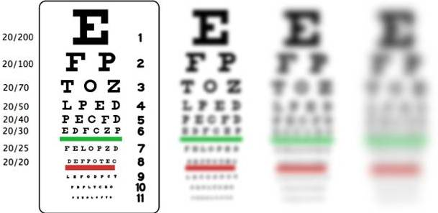
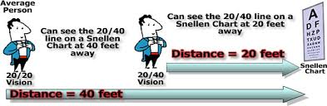
RPI - vision corollary

Slide 32
RPI
90/90 –
  level of proficiency on tasks that typical age- or grade-peers would perform with 90% proficiency
  55/90 on the Letter-Word Identification subtest would indicate that on similar tasks, the student would demonstrate 55% profiencieny, whereas age- or grade-peers would demonstrate 90% accurac
Independent Level = RPI 96/90 or above (EASY)
Instructional Level = RPI 95/90 to 76/90
Frustration Level = RPI 75/90 or below (DIFFICULT)

Slide 33
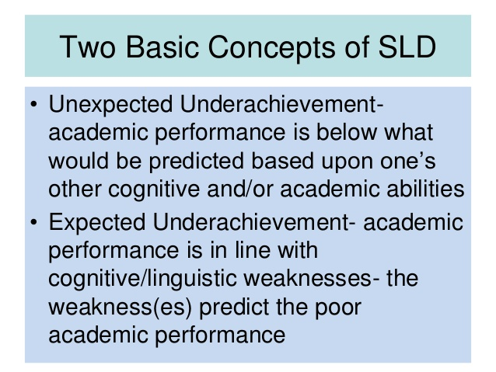

Slide 34
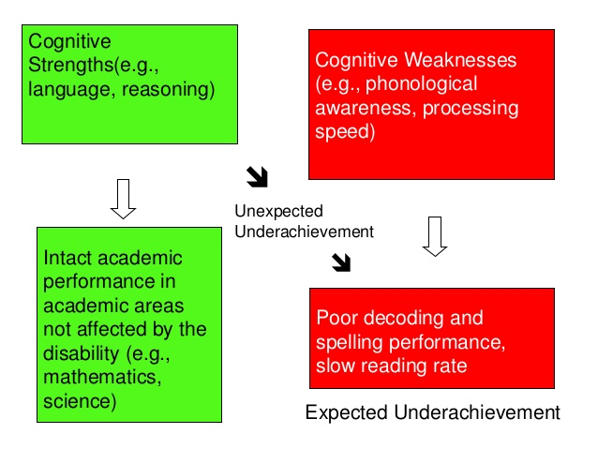

Slide 35
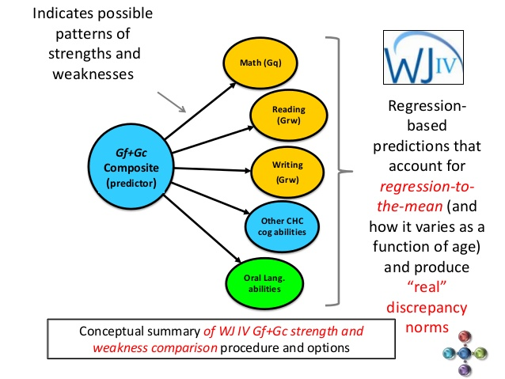

Slide 36
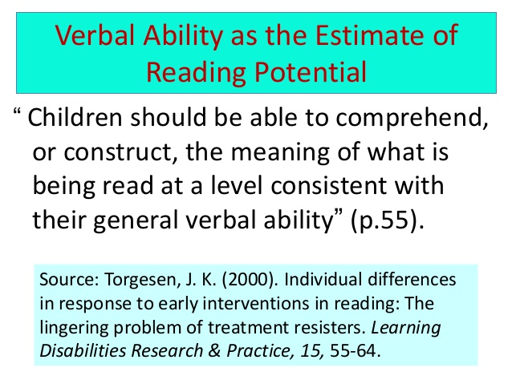

Slide 37
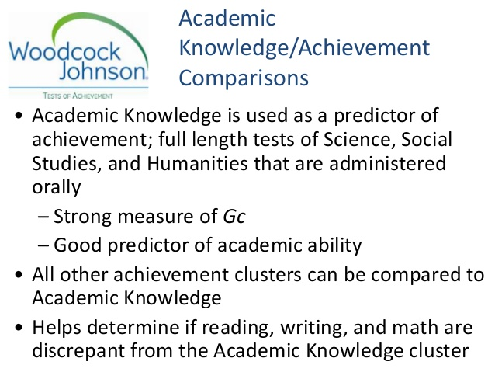

Slide 38
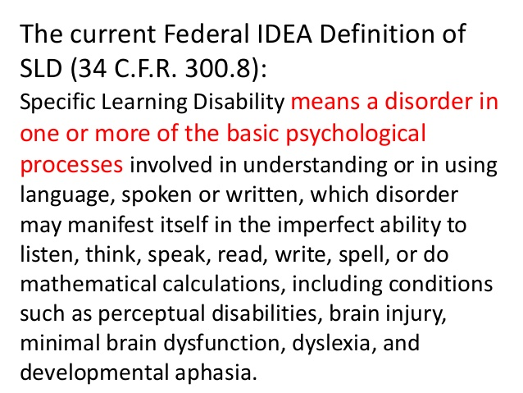

Slide 39
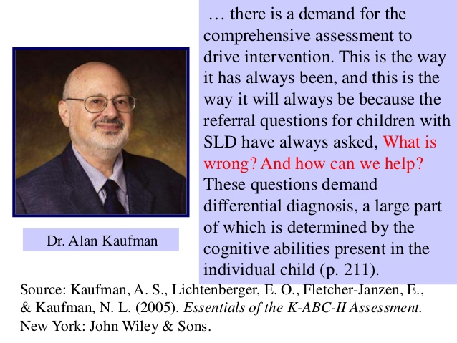

Slide 40
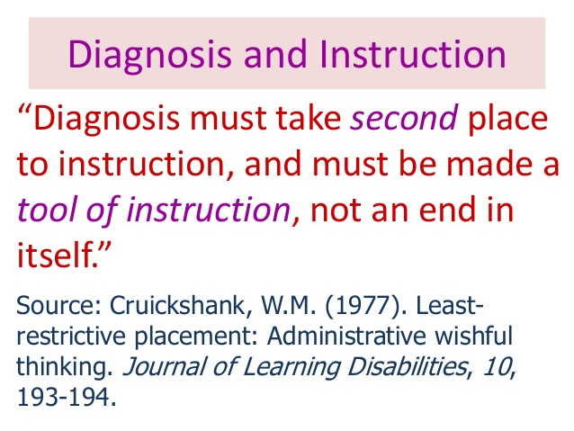

Slide 41
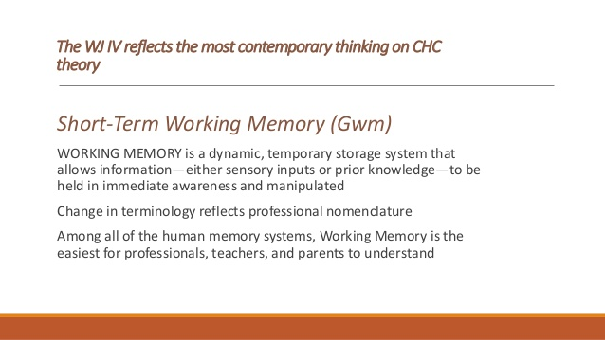

Slide 42
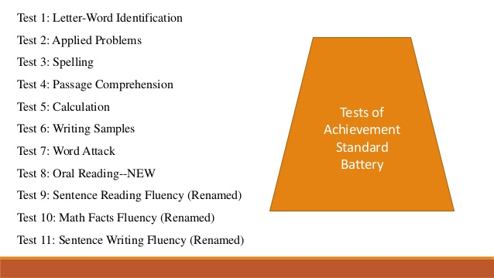

Slide 43
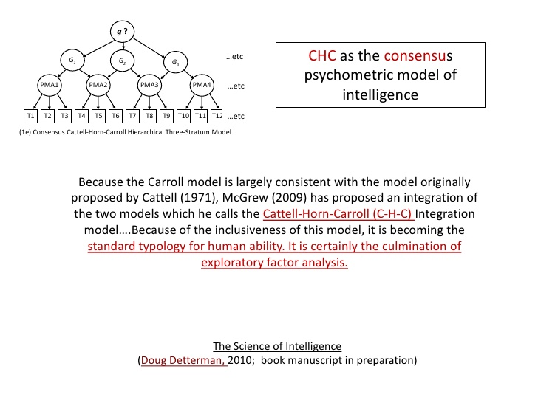

Slide 44
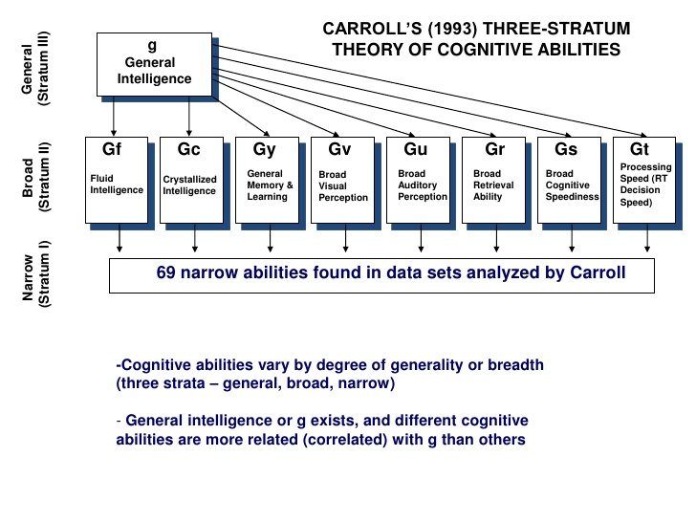

Slide 45
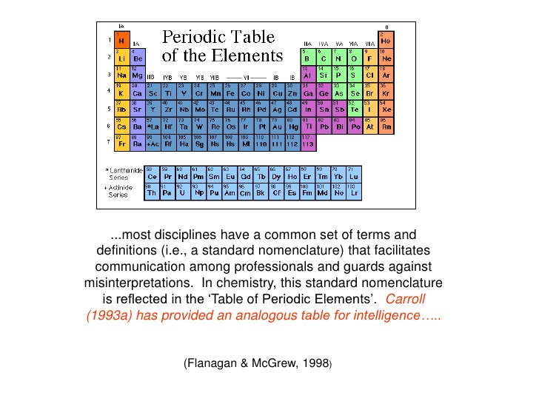

Slide 46
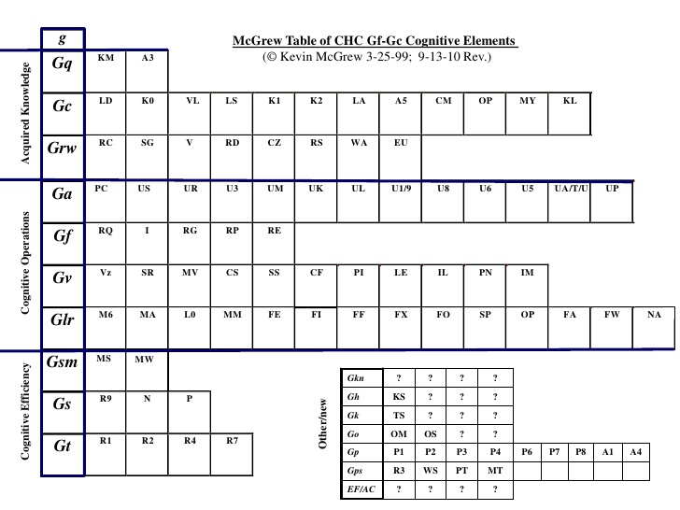

Slide 47
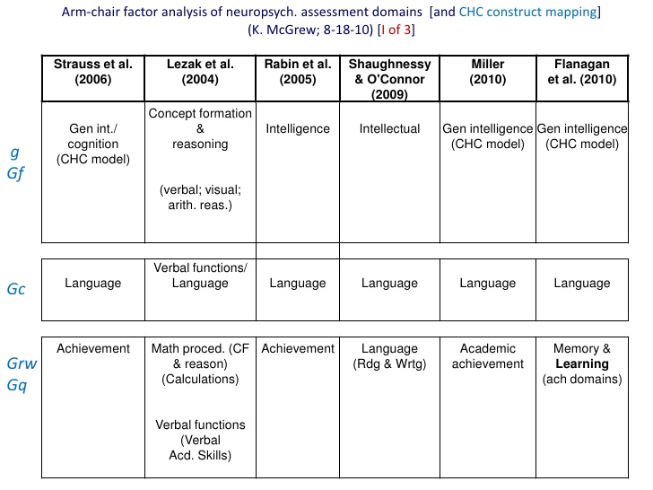

Slide 48
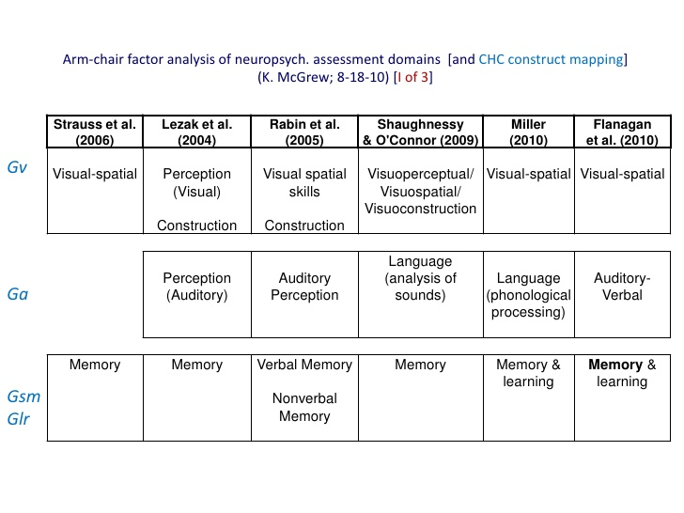

Slide 49
